Slide 1
Lecture 9 3D Modeling and Animation Assoc.Prof.Dr. Hossam Mahmoud Moftah Associate professor – Faculty of computers and artificial intelligence– Beni-Suef University

Slide 2
Chapter 6 Rigging and Animation
Adapted from Andy Beane: 3D animation essentials 2012 by John Wiley & Sons, Inc.,

Slide 3
Rigging and animation
Rigging and animation could not be more fundamentally different from one another, but they are so closely linked in 3D animation that one cannot really exist without the other.
This chapter presents the fundamental tools and techniques used by 3D animators today, from hand-key framed animation to motion capture, and basic hierarchy rigging to complicated character rigs.
Adapted from Andy Beane: 3D animation essentials 2012 by John Wiley & Sons, Inc.,

Slide 4
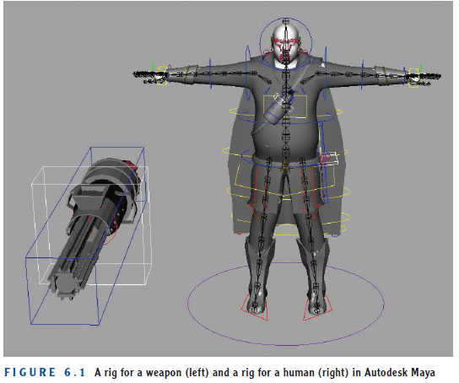
Rigging
Rigging
All 3D geometry that is going to be animated needs some type of system that provides the animators the control and flexibility needed to move that object in some fashion.
This control system is called the rig. Figure 6.1 shows examples of rigs.
Rigging
Adapted from Andy Beane: 3D animation essentials 2012 by John Wiley & Sons, Inc.,

Slide 5
Rigging
Rigging artists create the control system for animators to use in the animation process, much like puppet-makers create the control systems for puppeteers.
The rigger’s primary job is to make the animator’s job easier.
This is one of the only roles at a 3D animation studio that works specifically to aid a different department.
The rigging job is highly technical yet requires an artist’s fine touch.
Adapted from Andy Beane: 3D animation essentials 2012 by John Wiley & Sons, Inc.,

Slide 6
Rigging
Riggers need a deep understanding of the inner workings of whatever software and hardware they are using,
as well as a firm grasp of computer scripting and expression writing.
Knowledge of anatomy, human or animal, is also useful. Because riggers’ primary work is to help animators,
they need a fairly good understanding of character and object animation in order to know how to create efficient controls.
Adapted from Andy Beane: 3D animation essentials 2012 by John Wiley & Sons, Inc.,

Slide 7
Rigging
Steps:
The rigging artist starts by placing a skeleton made of joints, or bones, into the character or object.
These hierarchy-based pivot points can be selected and articulated, and are positioned similarly to the real bones within our bodies.
An alternative to using a skeleton is to use a simple hierarchical system based on parent-child relationships.
Next, riggers create controllers that will enable the animators to translate or rotate the joints.
The riggers then using deformers (tools that change the shape of an object) called skinning or enveloping connect the geometry to the joint/bone system so that the character’s geometry will follow the underlying rig.
Finally, riggers create other deformers to allow the geometry to move more realistically, with folds and skin displacement.
Adapted from Andy Beane: 3D animation essentials 2012 by John Wiley & Sons, Inc.,

Slide 8
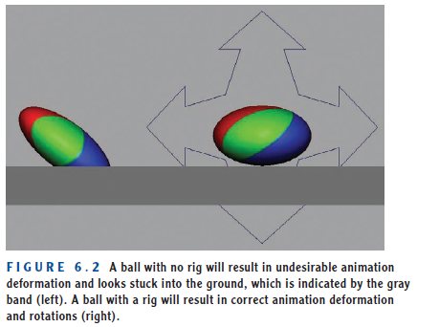
Rigging
Adapted from Andy Beane: 3D animation essentials 2012 by John Wiley & Sons, Inc.,

Slide 9
Tools and techniques available to riggers today.
Parenting
All rigs are based on a hierarchy of systems and controls working in a sequential order to create the articulation of your object.
This hierarchy in its most basic form is a parent/child relationship—one object is the parent, and another object is the child.
Creating this relationship is called parenting.
child object can move, rotate, and scale independently of the parent object, but when the parent object moves, the child will follow.
You can have multiple children under a parent, called siblings, and can even have children of children, as shown in Figure 6.3.
In most 3D applications, you can change this parent and child relationship at any time.
You can parent objects to each other, or you can group objects together to move as a unit.
Adapted from Andy Beane: 3D animation essentials 2012 by John Wiley & Sons, Inc.,

Slide 10
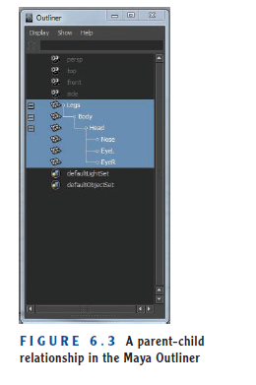
Tools and techniques available to riggers today.
Parenting
Adapted from Andy Beane: 3D animation essentials 2012 by John Wiley & Sons, Inc.,

Slide 11
Tools and techniques available to riggers today.
2. Pivot Positions
The pivot position, or pivot point, is the location an object rotates around.
In 3D animation, the pivot point is also the position from which the other manipulators will move or scale the object.
Setting the correct position of the pivot to create the proper point of manipulation is important in creating a rig.
Figure 6.4 shows an example of a basic hierarchy rig. This rig is just a basic parent-child relationship rig with all of its parts connected.
Adapted from Andy Beane: 3D animation essentials 2012 by John Wiley & Sons, Inc.,

Slide 12
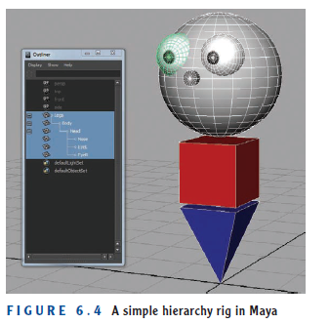
Tools and techniques available to riggers today.
2. Pivot Positions
Adapted from Andy Beane: 3D animation essentials 2012 by John Wiley & Sons, Inc.,

Slide 13
Tools and techniques available to riggers today.
2. Pivot Positions
To move the head sphere in a proper way to match predictable head rotations, the pivot point has to be close to the connection point of the body.
the default pivot point of a sphere is at the center, which will not articulate like a head on a neck, but instead will rotate as shown in Figure 6.5.
By moving the pivot point down, you can create the proper motion needed for a head, as seen in Figure 6.6.
Adapted from Andy Beane: 3D animation essentials 2012 by John Wiley & Sons, Inc.,

Slide 14
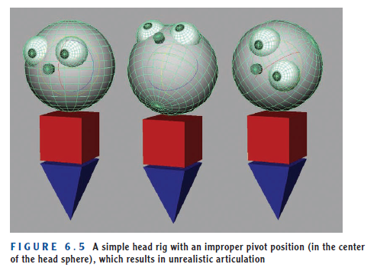
Tools and techniques available to riggers today.
2. Pivot Positions
Adapted from Andy Beane: 3D animation essentials 2012 by John Wiley & Sons, Inc.,

Slide 15
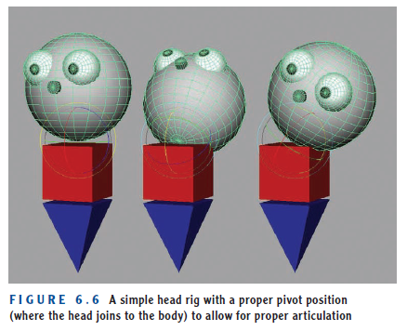
Tools and techniques available to riggers today.
2. Pivot Positions
Adapted from Andy Beane: 3D animation essentials 2012 by John Wiley & Sons, Inc.,

Slide 16
Tools and techniques available to riggers today.
3. Skeleton System
The rigger creates a skeleton system, or joints, composed of a hierarchal set of pivot points that can be selected and set to carry specific types of deformers with them.
Figure 6.7 shows an example of a skeleton. This skeleton system is the basis for any mid-level to advanced character rig.
Joints can be used in nonorganic models such as cars and weapons as well to allow for easier selection and deformation.
Adapted from Andy Beane: 3D animation essentials 2012 by John Wiley & Sons, Inc.,

Slide 17
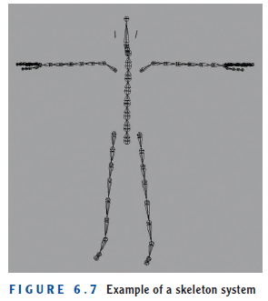
Tools and techniques available to riggers today.
3. Skeleton System
Adapted from Andy Beane: 3D animation essentials 2012 by John Wiley & Sons, Inc.,

Slide 18
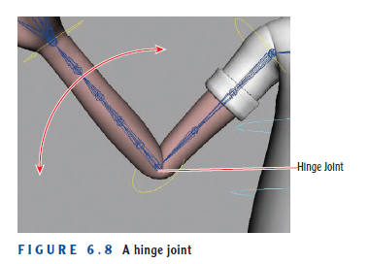
Tools and techniques available to riggers today.
3. Skeleton System
Let’s look at a few examples of the types of movement that joints can allow in a character.
Four basic types of joints can create any type of character articulation:
A hinge joint rotates on one axis, as a knee or elbow would. Figure 6.8 shows an example.
Adapted from Andy Beane: 3D animation essentials 2012 by John Wiley & Sons, Inc.,

Slide 19
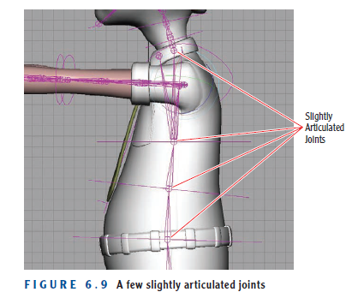
Tools and techniques available to riggers today.
3. Skeleton System
Four basic types of joints can create any type of character articulation:
2. An articulated joint can rotate a small amount if desired, but many of these joints rotating at once can create a large range of motion, as in a spine (see Figure 6.9).
Adapted from Andy Beane: 3D animation essentials 2012 by John Wiley & Sons, Inc.,

Slide 20
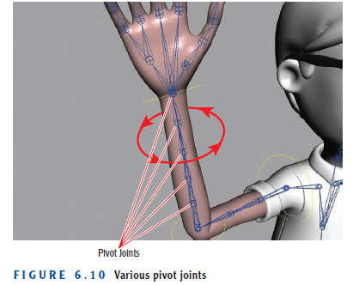
Tools and techniques available to riggers today.
3. Skeleton System
Four basic types of joints can create any type of character articulation:
3. A pivot joint rotates around a single axis, like those in the forearm shown in Figure 6.10.
Adapted from Andy Beane: 3D animation essentials 2012 by John Wiley & Sons, Inc.,

Slide 21
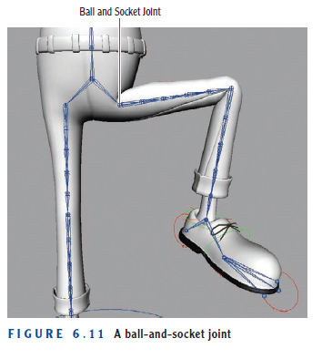
Tools and techniques available to riggers today.
3. Skeleton System
Four basic types of joints can create any type of character articulation:
4. A ball-and-socket joint can rotate in any direction, as in a shoulder or a hip (see Figure 6.11).
Adapted from Andy Beane: 3D animation essentials 2012 by John Wiley & Sons, Inc.,

Slide 22
The End

